Slide 1
Chapter 4: The Enhanced E-R Model and Business Rules
Modern Database Management
6th Edition
Jeffrey A. Hoffer, Mary B. Prescott, Fred R. McFadden

Slide 2
Supertypes and Subtypes
Subtype: A subgrouping of the entities in an entity type which has attributes that are distinct from those in other subgroupings
Supertype: An generic entity type that has a relationship with one or more subtypes
Inheritance:
Subtype entities inherit values of all attributes of the supertype
An instance of a subtype is also an instance of the supertype

Slide 3
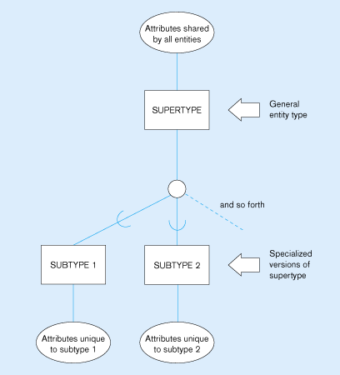
Figure 4-1
Basic notation for supertype/subtype relationships

Slide 4
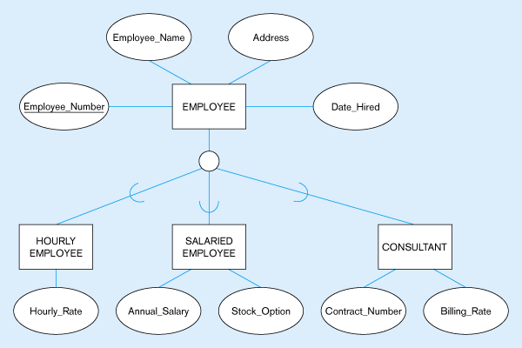
Figure 4-2 -- Employee supertype with three subtypes
All employee subtypes will have emp nbr, name, address, and date-hired
Each employee subtype will also have its own attributes

Slide 5
Relationships and Subtypes
Relationships at the supertype level indicate that all subtypes will participate in the relationship
The instances of a subtype may participate in a relationship unique to that subtype. In this situation, the relationship is shown at the subtype level

Slide 6
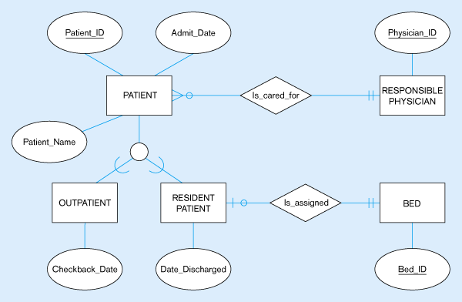
Figure 4-3 -- Supertype/subtype relationships in a hospital
Both outpatients and resident patients are cared for by a responsible physician
Only resident patients are assigned to a bed

Slide 7
Generalization and Specialization
Generalization: The process of defining a more general entity type from a set of more specialized entity types. BOTTOM-UP
Specialization: The process of defining one or more subtypes of the supertype, and forming supertype/subtype relationships. TOP-DOWN

Slide 8
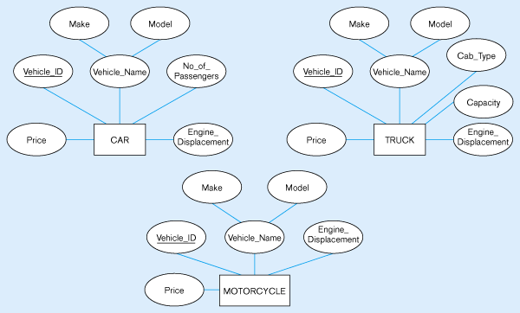
Figure 4-4 – Example of generalization
(a) Three entity types: CAR, TRUCK, and MOTORCYCLE
All these types of vehicles have common attributes

Slide 9
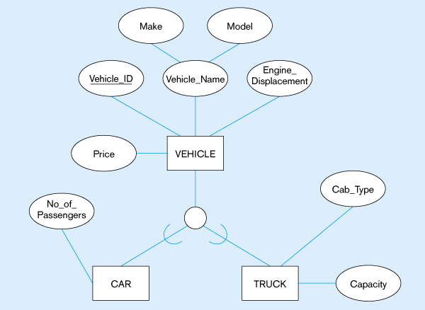
Figure 4-4(b) – Generalization to VEHICLE supertype
So we put the shared attributes in a supertype
Note: no subtype for motorcycle, since it has no unique attributes

Slide 10
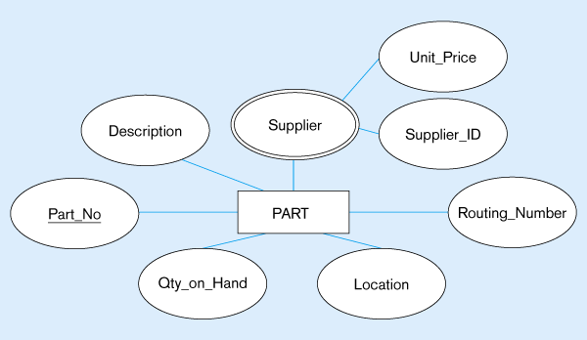
Figure 4-5 – Example of specialization
(a) Entity type PART
Applies only to purchased parts
Only applies to manufactured parts

Slide 11
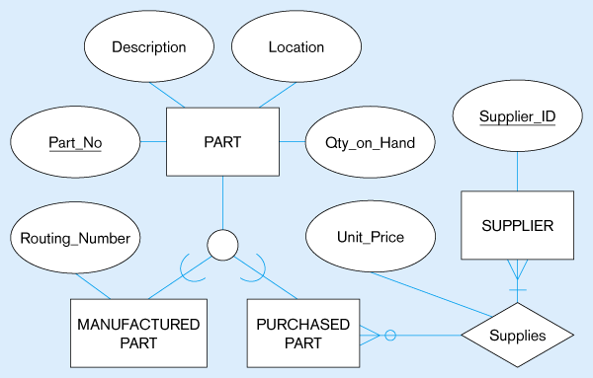
Figure 4-5(b) –
Specialization to MANUFACTURED PART and PURCHASED PART
Created 2 subtypes
Note: multivalued attribute was replaced by a relationship to another entity

Slide 12
Constraints in Supertype/ Completeness Constraint
Completeness Constraints: Whether an instance of a supertype must also be a member of at least one subtype
Total Specialization Rule: Yes (double line)
Partial Specialization Rule: No (single line)

Slide 13
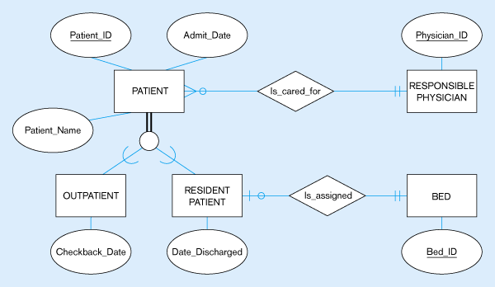
Figure 4-6 – Examples of completeness constraints
(a) Total specialization rule
A patient must be either an outpatient or a resident patient

Slide 14
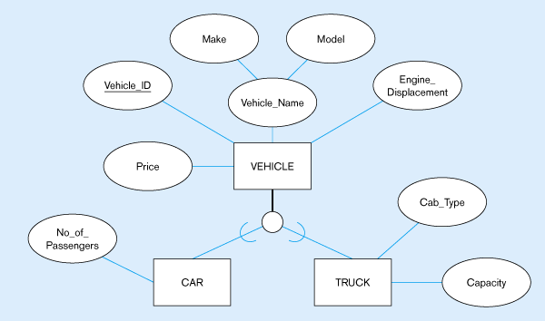
Figure 4-6(b) – Partial specialization rule
A vehicle could be a car, a truck, or neither

Slide 15
Constraints in Supertype/ Disjointness constraint
Disjointness Constraints: Whether an instance of a supertype may simultaneously be a member of two (or more) subtypes.
Disjoint Rule: An instance of the supertype can be only ONE of the subtypes
Overlap Rule: An instance of the supertype could be more than one of the subtypes

Slide 16
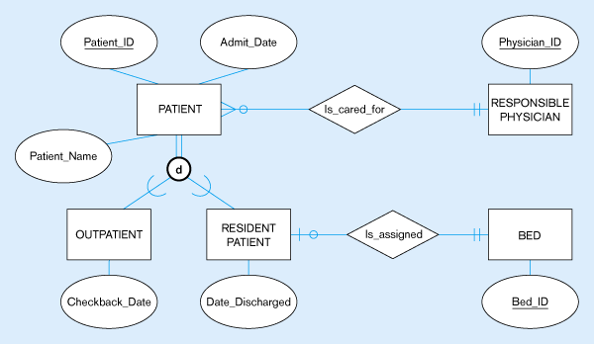
Figure 4-7 – Examples of disjointness constraints
(a) Disjoint rule
A patient can either be outpatient or resident, but not both

Slide 17
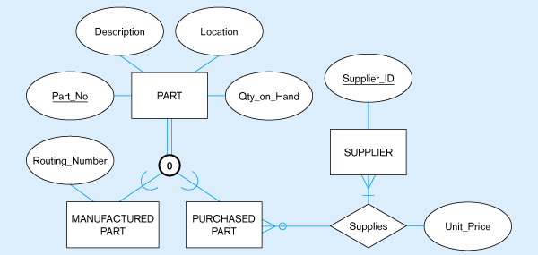
Figure 4-7(b) Overlap rule
A part may be both purchased and manufactured

Slide 18
Constraints in Supertype/ Subtype Discriminators
Subtype Discriminator: An attribute of the supertype whose values determine the target subtype(s)
Disjoint – a simple attribute with alternative values to indicate the possible subtypes
Overlapping – a composite attribute whose subparts pertain to different subtypes. Each subpart contains a boolean value to indicate whether or not the instance belongs to the associated subtype

Slide 19
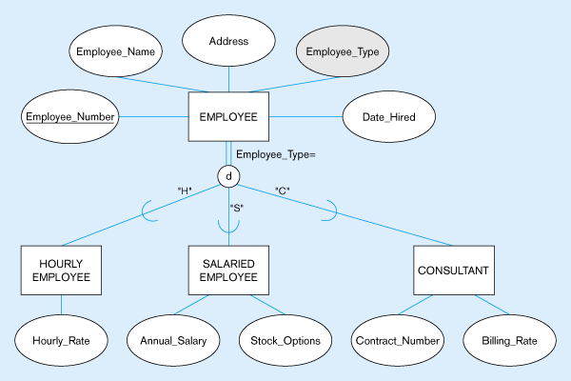
Figure 4-8 – Introducing a subtype discriminator (disjoint rule)
A simple attribute with different possible values indicating the subtype

Slide 20
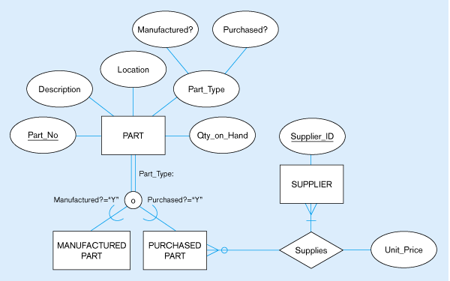
Figure 4-9 – Subtype discriminator (overlap rule)
A composite attribute with sub-attributes indicating “yes” or “no” to determine whether it is of each subtype

Slide 21
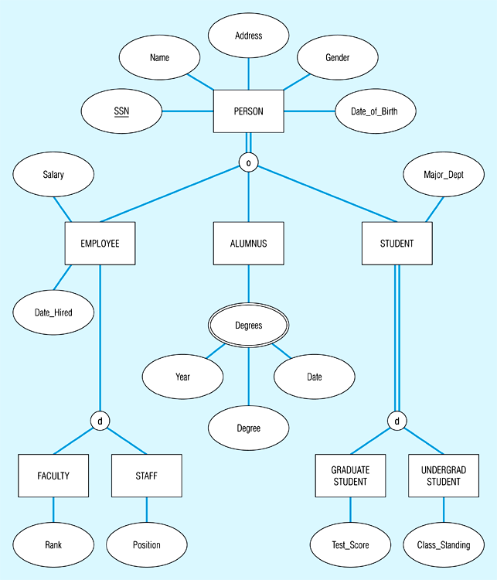
Figure 4-10 – Example of supertype/subtype hierarchy

Slide 22
Entity Clusters
EER diagrams are difficult to read when there are too many entities and relationships
Solution: group entities and relationships into entity clusters
Entity cluster: set of one or more entity types and associated relationships grouped into a single abstract entity type

Slide 23
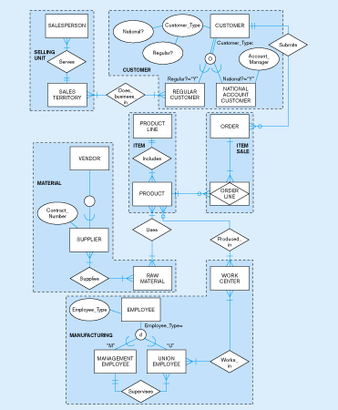
Figure 4-13(a) – Possible entity clusters for Pine Valley Furniture
Related groups of entities could become clusters

Slide 24
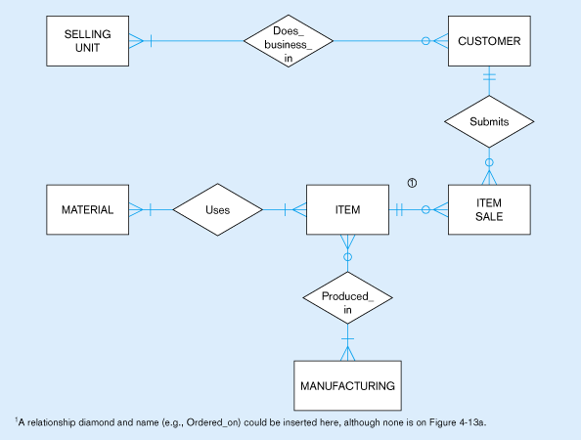
Figure 4-13(b) – EER diagram of PVF entity clusters
More readable, isn’t it?

Slide 25
Transforming EER Diagrams into Relations
Mapping Supertype/Subtype Relationships
One relation for supertype and for each subtype
Supertype attributes (including identifier and subtype discriminator) go into supertype relation
Subtype attributes go into each subtype; primary key of supertype relation also becomes primary key of subtype relation
1:1 relationship established between supertype and each subtype, with supertype as primary table

Slide 26
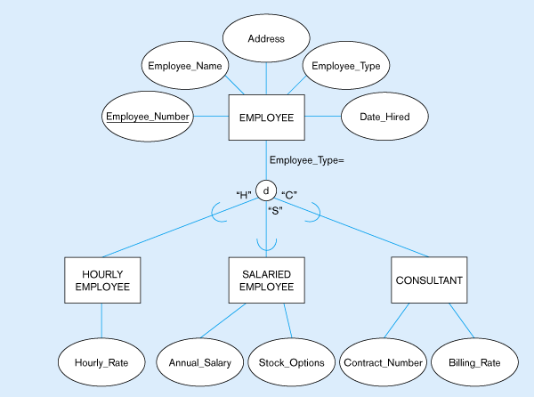
Figure 5-20: Supertype/subtype relationships

Slide 27
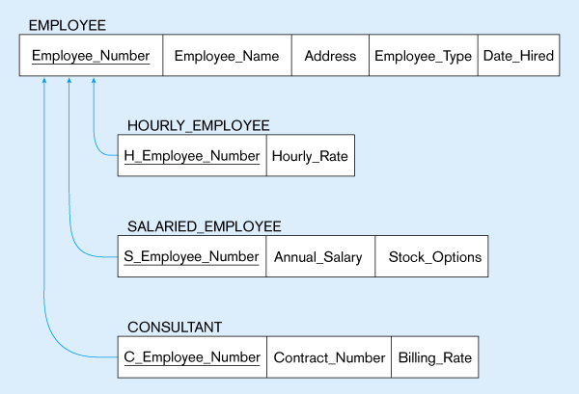
Figure 5-21:
Mapping Supertype/subtype relationships to relations

